Slide 1
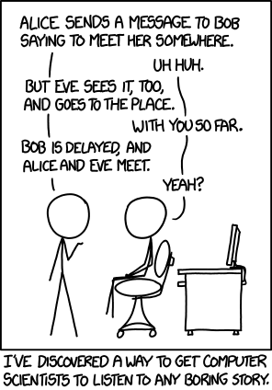

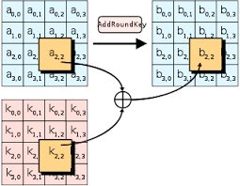
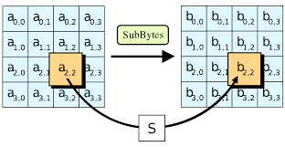
Introduction to Cryptography

Slide 2

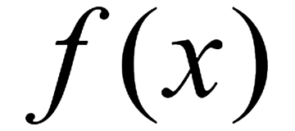
Introduction to Cryptography
PlainText
CipherText
Messages are numbers (bytes)
We can “do math” on bytes
That math obscures the plaintext
The harder to invert the function, (without special knowledge) the better the encryption

Slide 3
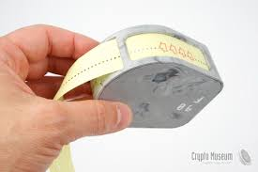



Symmetric Key Cryptography
Alice and Bob have same key.
How they share it is a *real* problem
How many keys are needed for N players? (graph theory question)

Slide 4
Symmetric Key Cryptography
Alice transforms the message using the pre-shared key to cipher text
Bob uses the pre-shared key to invert the function to reveal plain text
Knowing the key and f(x) makes both encryption and decryption simple/easy

Slide 5
Symmetric Key Cryptography
Eve observes the message in transit
Without the key, inverting the function is too costly/time consuming to be effective

Slide 6
Tweet Example (One Time Pad / Crib)
How long can a tweet be?
What if we generate a 140B “good” random number
We both take a copy of it to our remote locations
When I want to send you a message:
Create the message
XOR the message with the random number
Send it via an observable medium
You receive it and XOR the cipher text with the random number
How secure is this?
How hard was the transform with key knowledge?
How hard is the transform without key knowledge (even if Eve knows XOR transform)
What should we never do, (if we want to keep maintain confidentiality)?

Slide 7
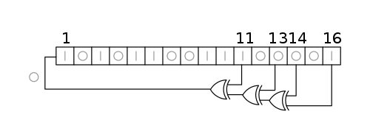

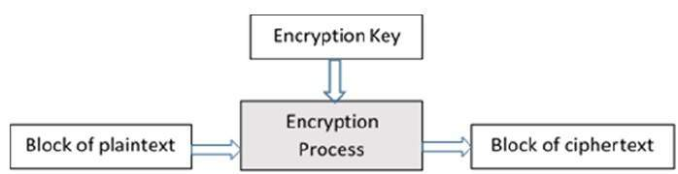
Block and Stream Ciphers
PlainText => CipherText

Slide 8

Asymmetric Key Cryptography (Trapdoor function)
I could give you an open lock
You could easily lock up my shed
Even you couldn’t easily get it open once you locked it
Are there mathematical functions with similar properties?
When open, it’s easy to close, no special knowledge or key needed
Once closed, not so easy to get open without key

Slide 9

Asymmetric Key Cryptography
Alice has a key that she keeps private
She leaves open locks in public

Slide 10
Asymmetric Key Cryptography
Bob grabs a lock and uses it to lock a message
Even bob can’t unlock the message he just created

Slide 11
Asymmetric Key Cryptography
Just like Bob, Eve can’t decrypt the message either
Alice uses her key to reverse the trapdoor function

